Slide 1



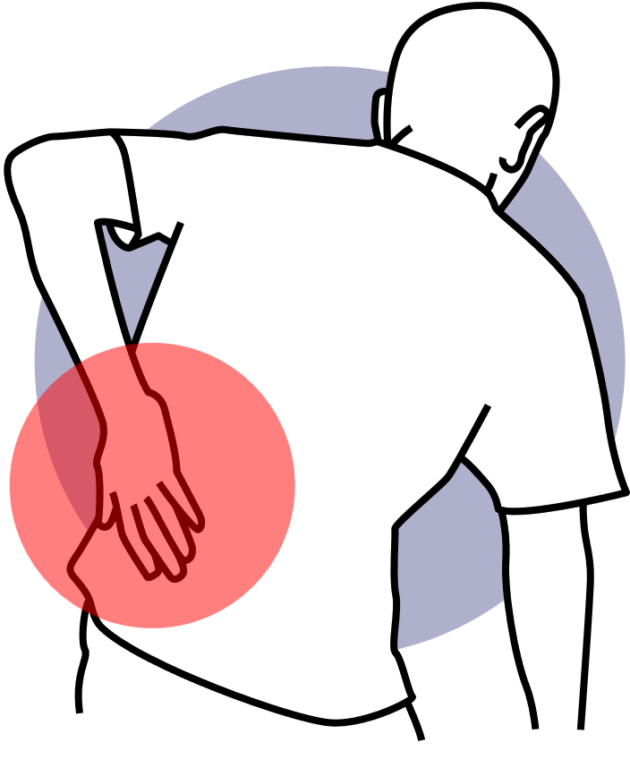



Strengthening For A Healthy Back

Slide 2




Why Strength Matters
Strong muscles support your spine, reduce injury risk, and improve daily function
A strong core is like armor for your back — it absorbs stress and keeps you stable

Slide 3


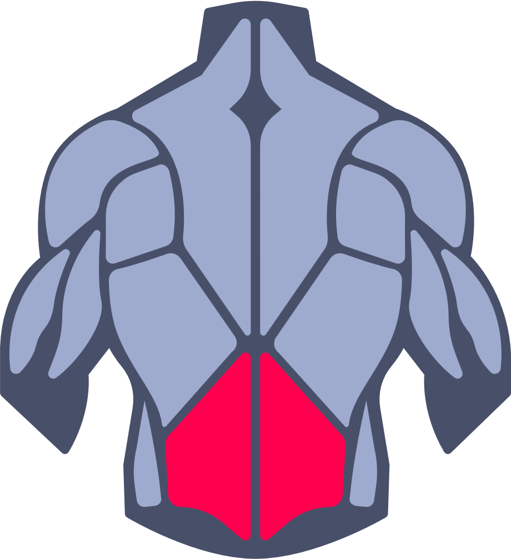
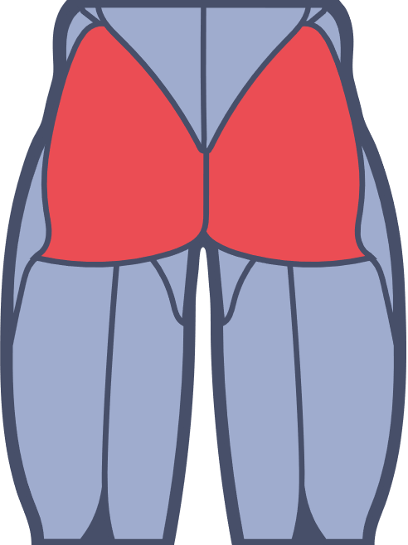
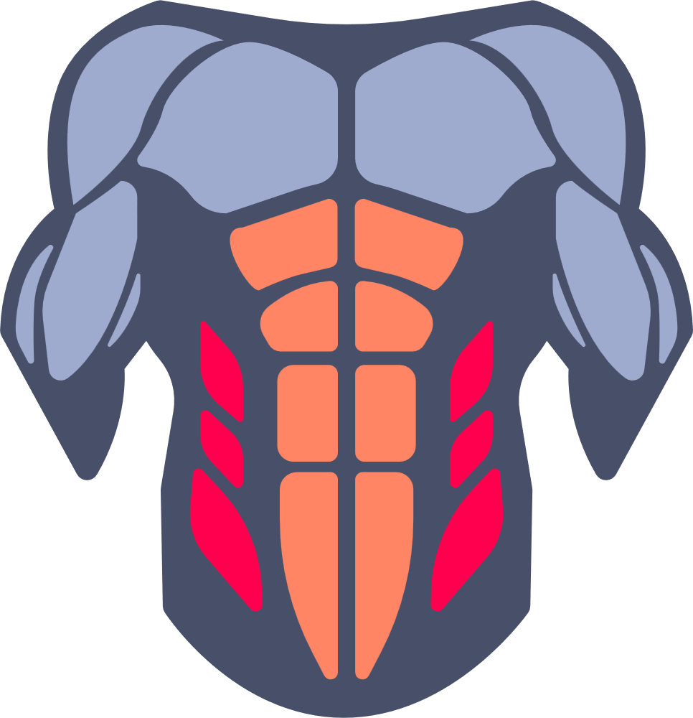

The Core Defined
Glutes
Obliques
Abdominals
Lower Back / Hips
The core is 360° — front, sides, and back. It’s the center of all movement

Slide 4
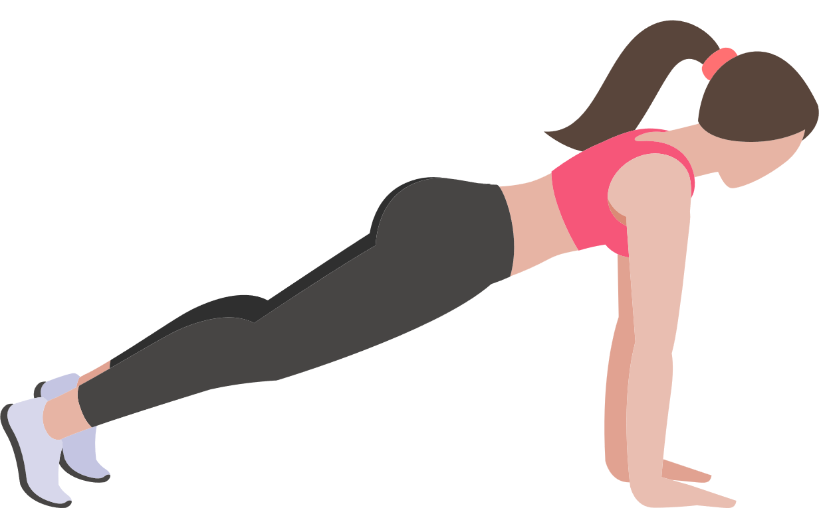
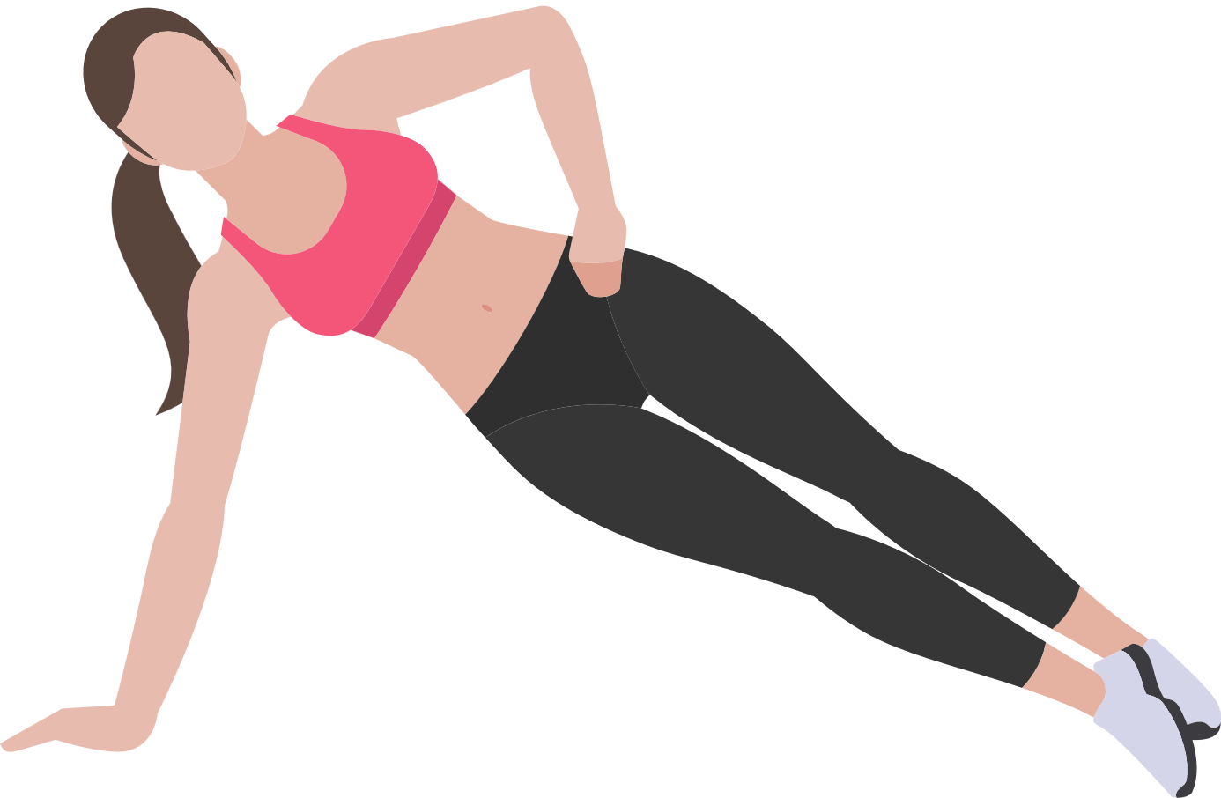
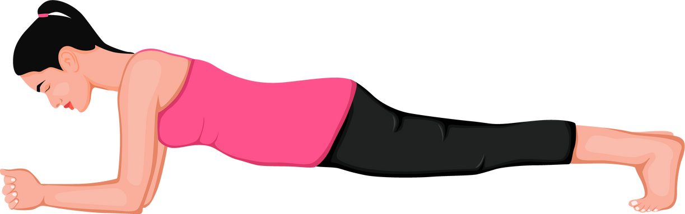
Best Core Exercises
These exercises strengthen without straining. You don’t need crunches — these are safer and more effective
Front and Side Planks

Slide 5
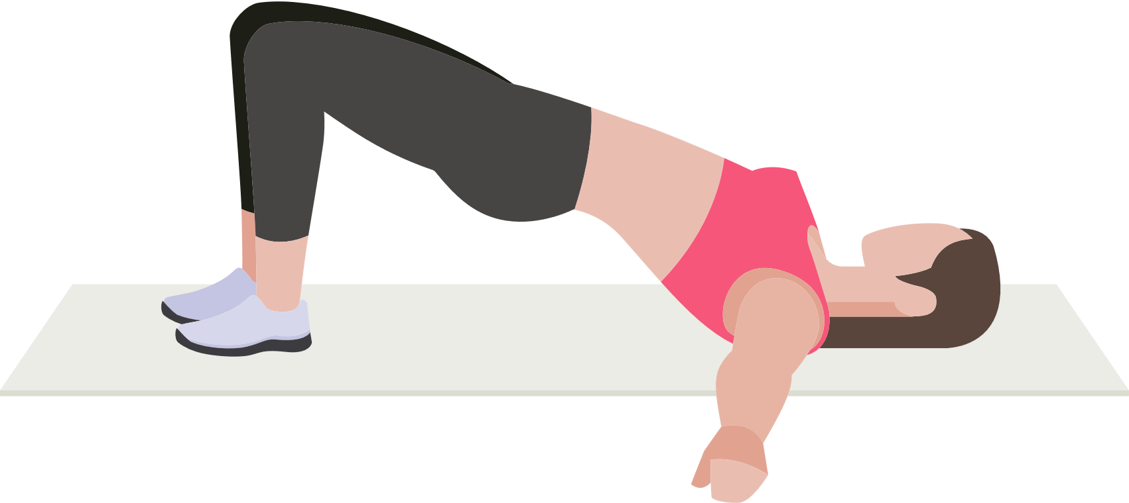
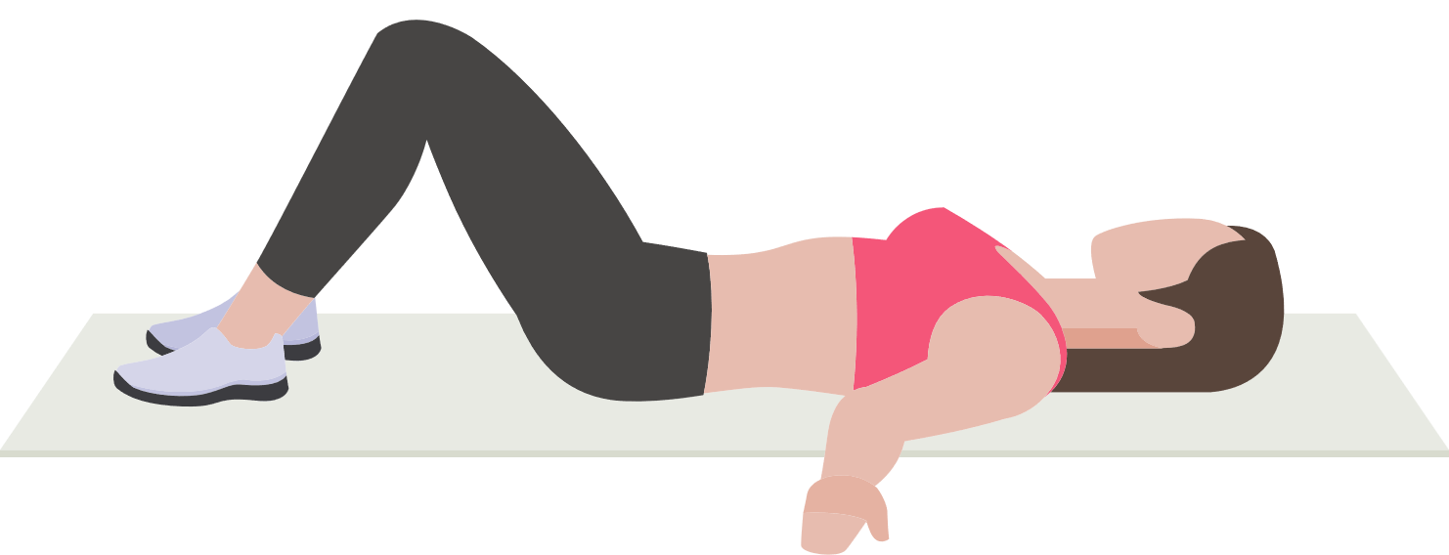
Best Core Exercises
Glute Bridges

Slide 6
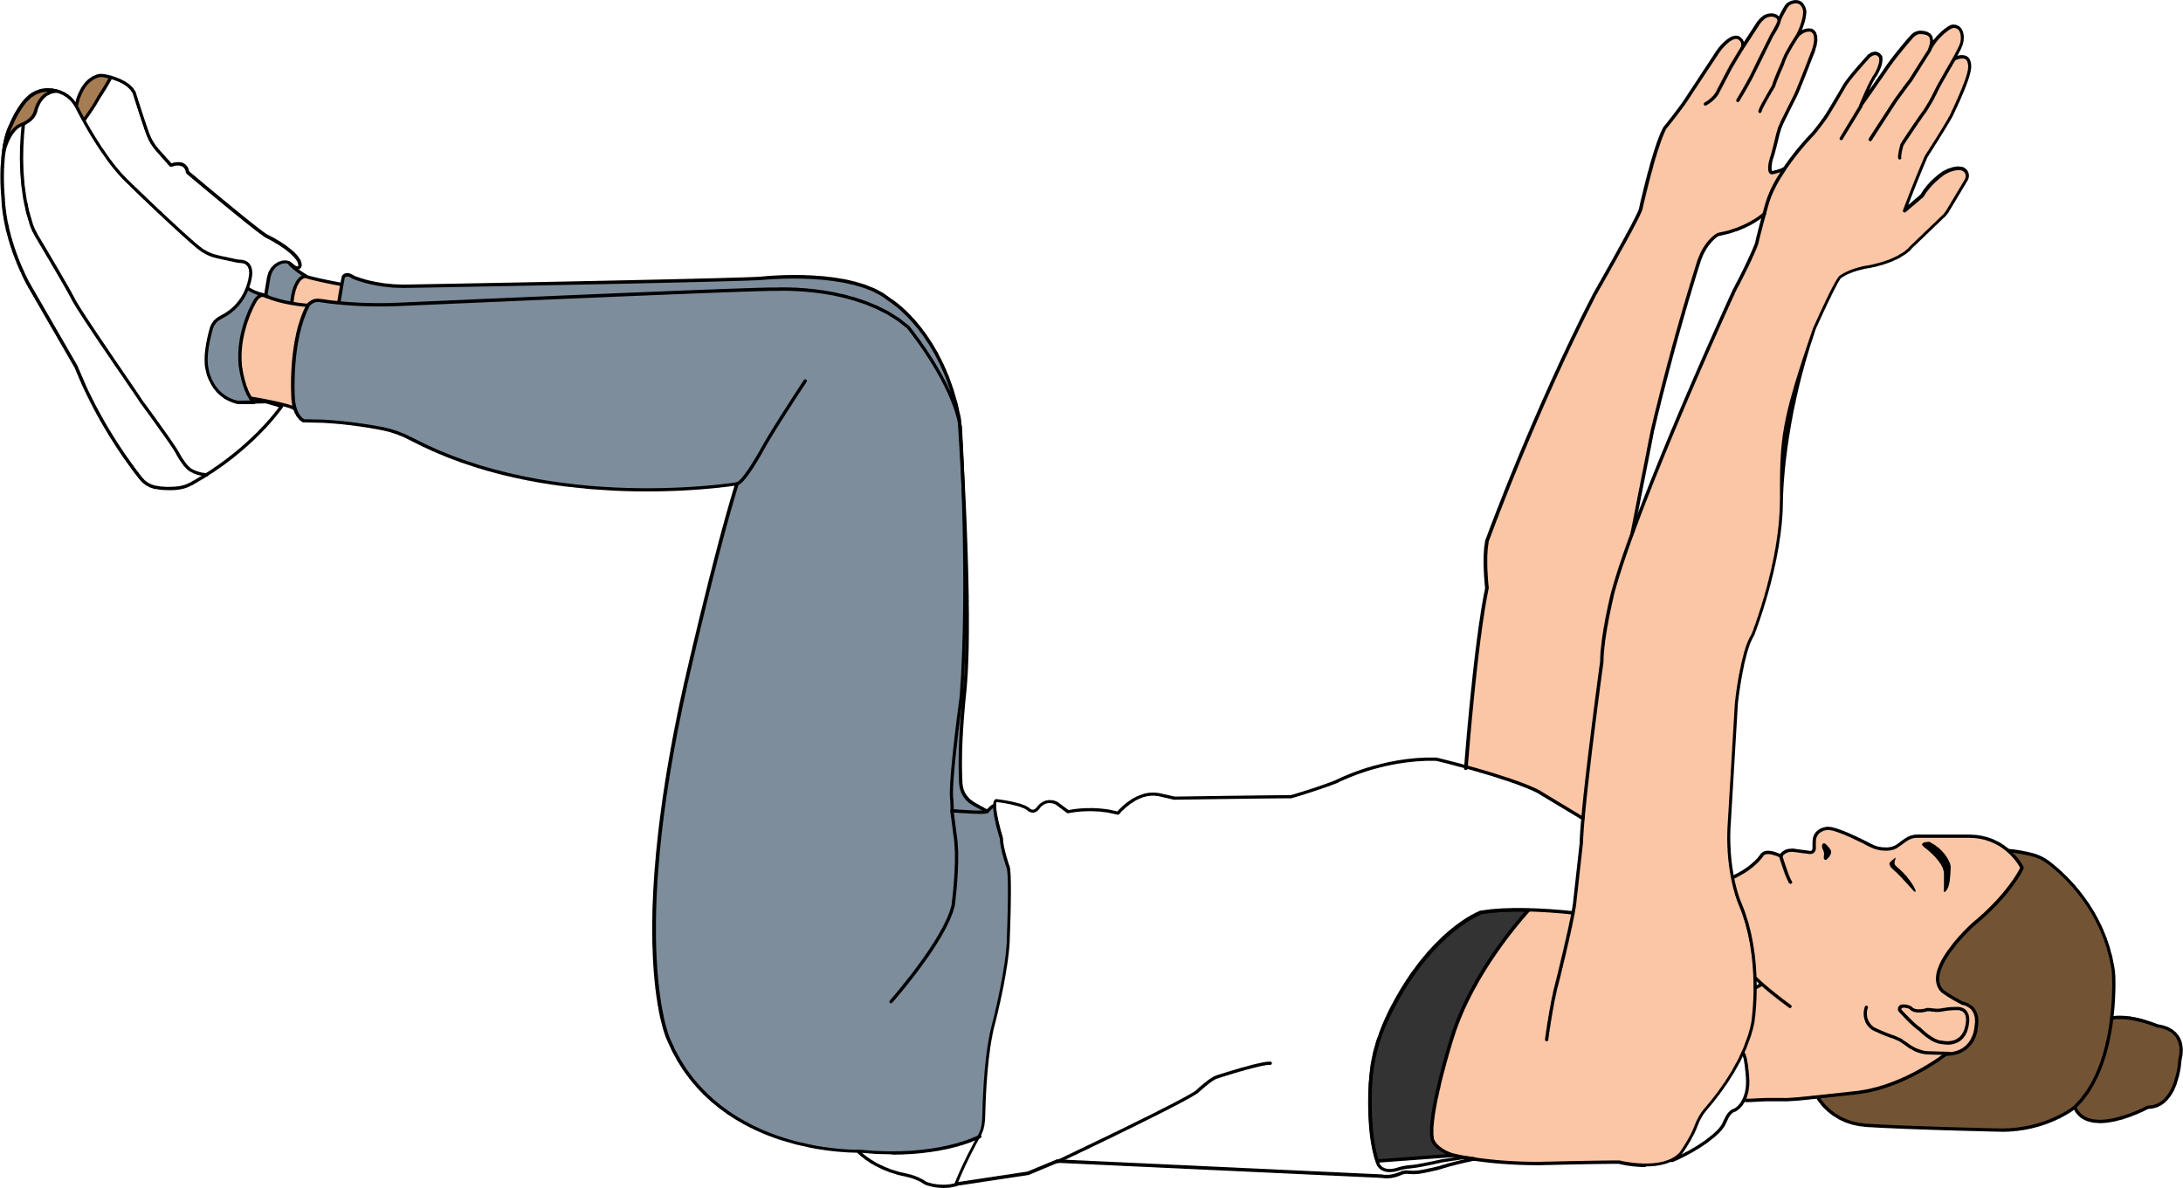
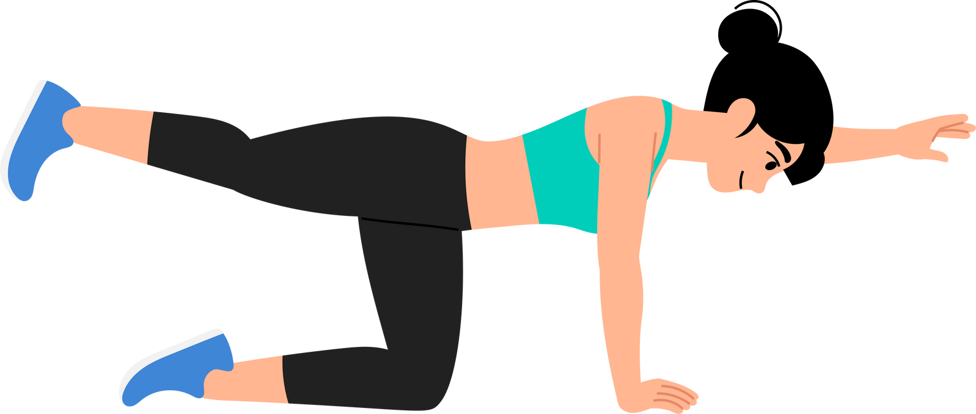
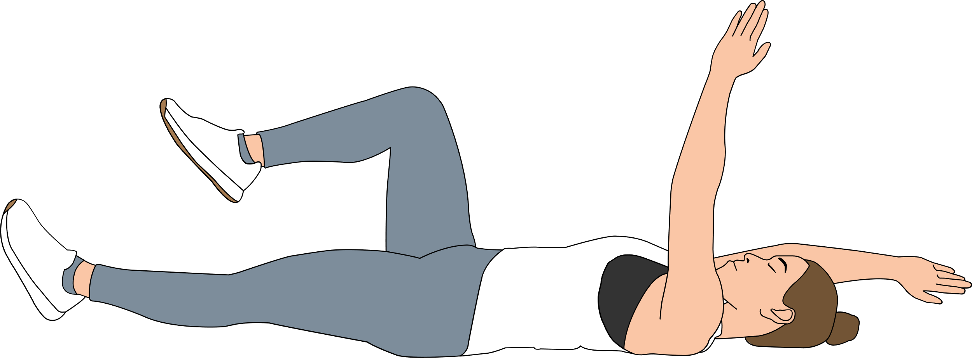
Best Core Exercises
Bird-Dog & Dead Bug

Slide 7
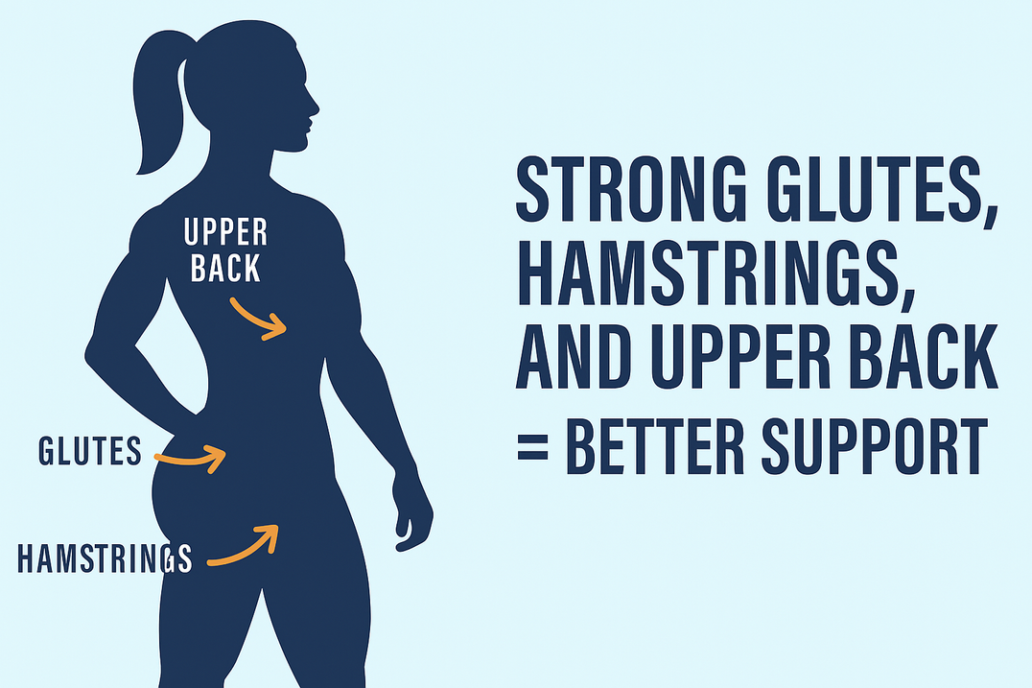


It’s Not Just Core
It’s not just the core. Your glutes, hamstrings, and upper back keep posture upright and stable

Slide 8
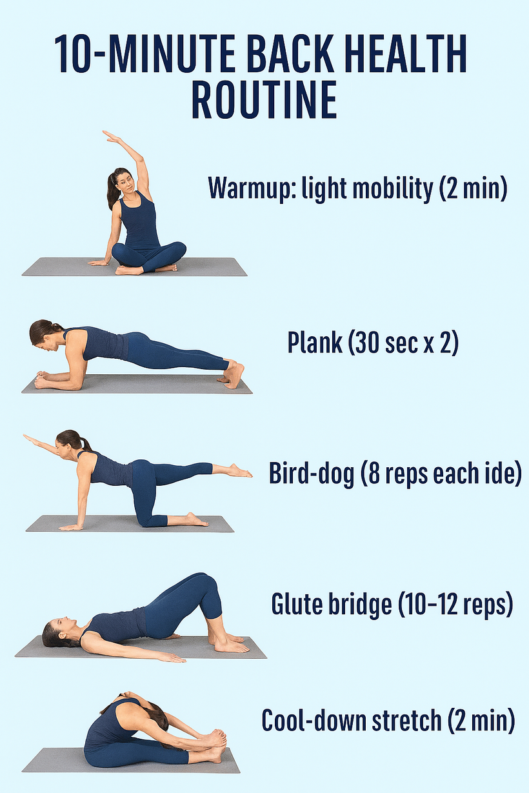
Easy
Routine

Slide 9
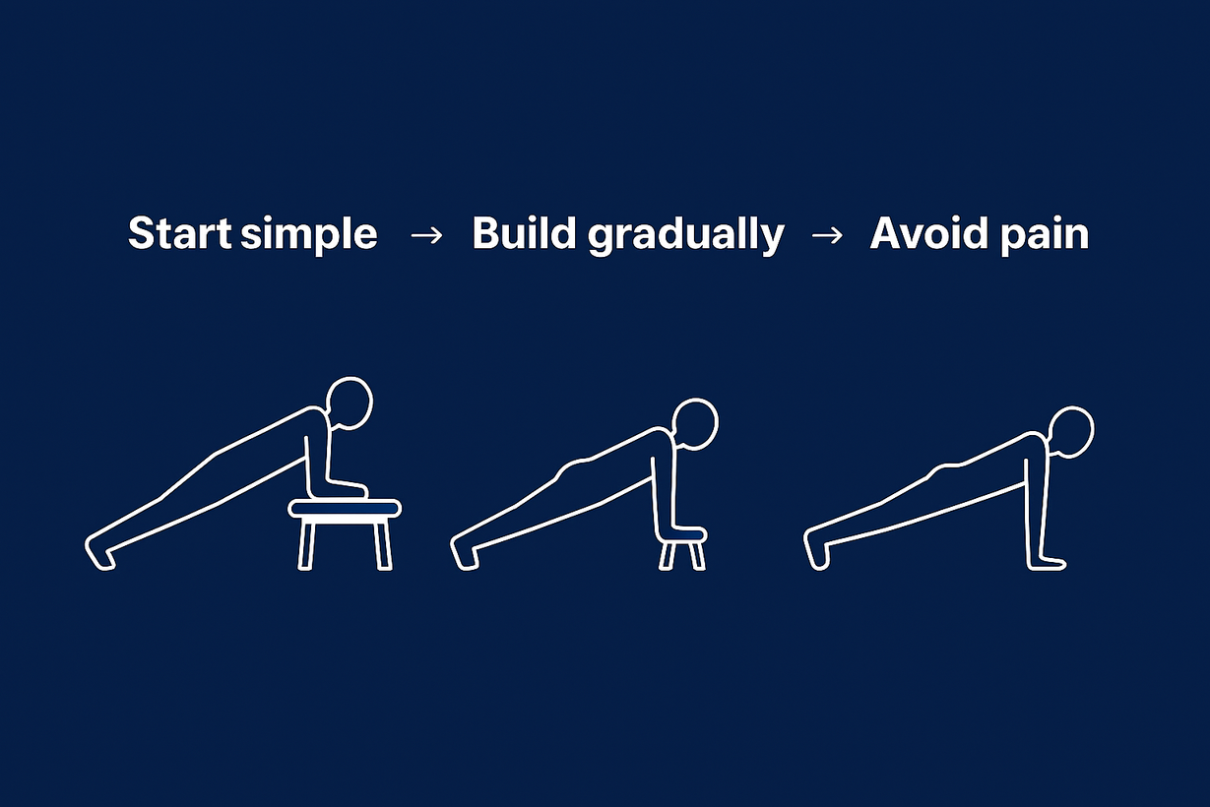
Closing Thoughts
Listen to your body. Increase time and reps slowly. If it hurts, stop

Slide 10

Takeaway
Stronger Core = Stronger Back
  Build core strength
  Train support muscles
  Stay consistent

