Slide 1



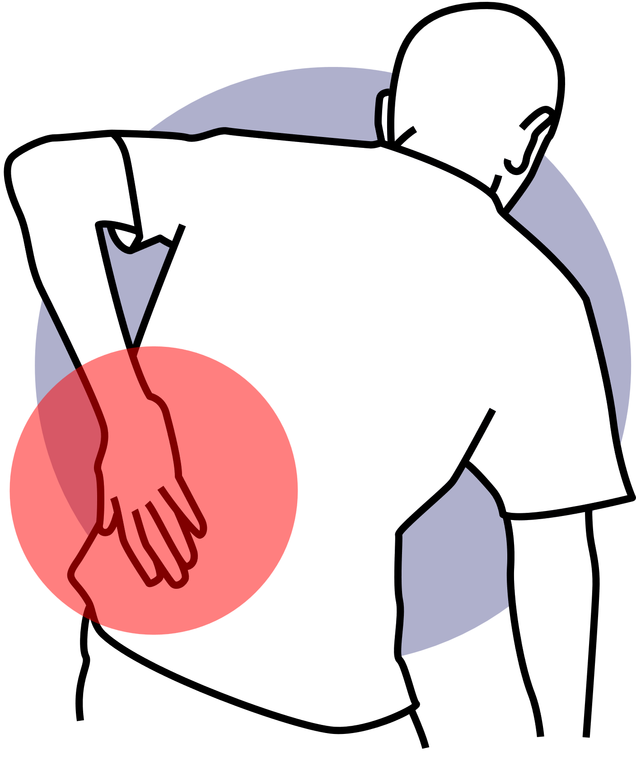



Managing Back Pain

Slide 2

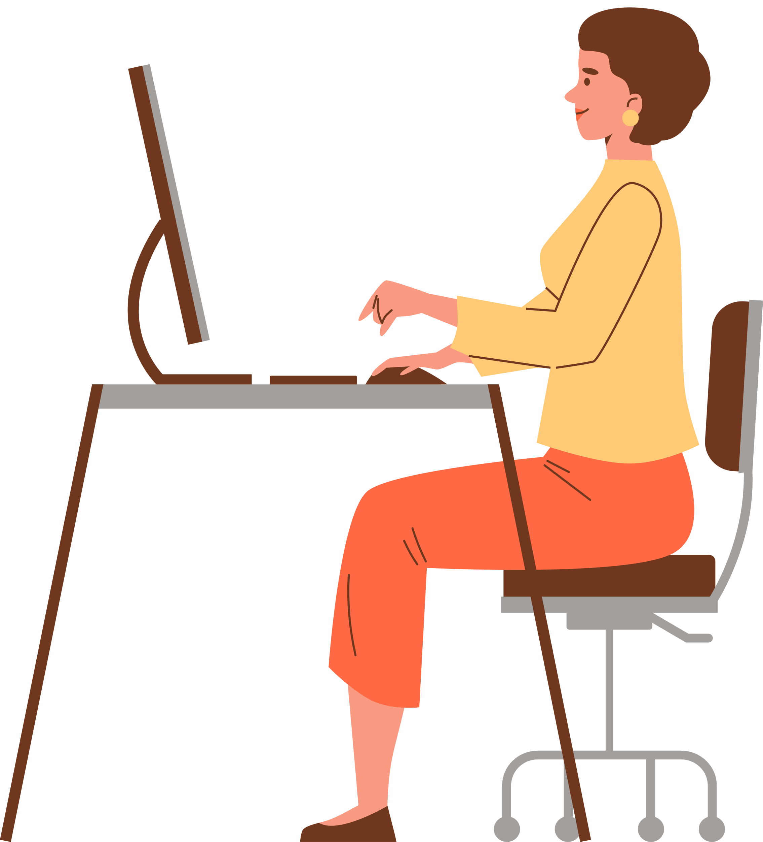
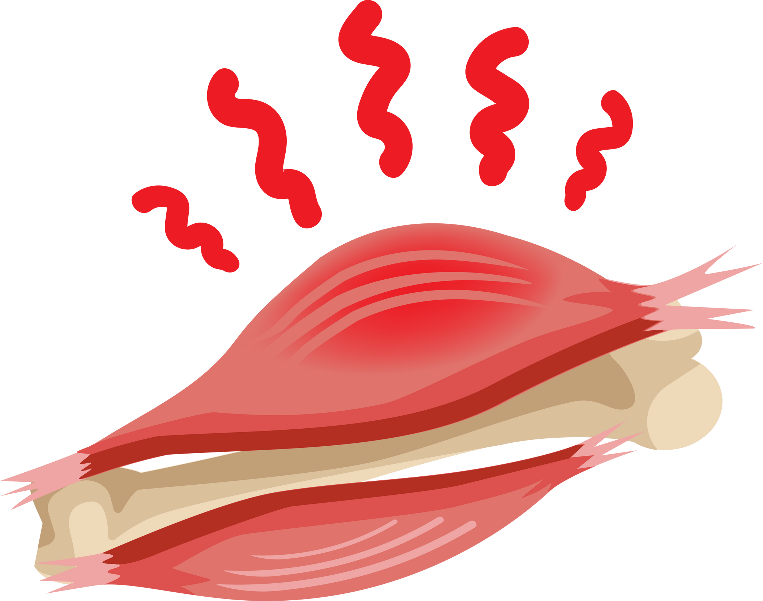
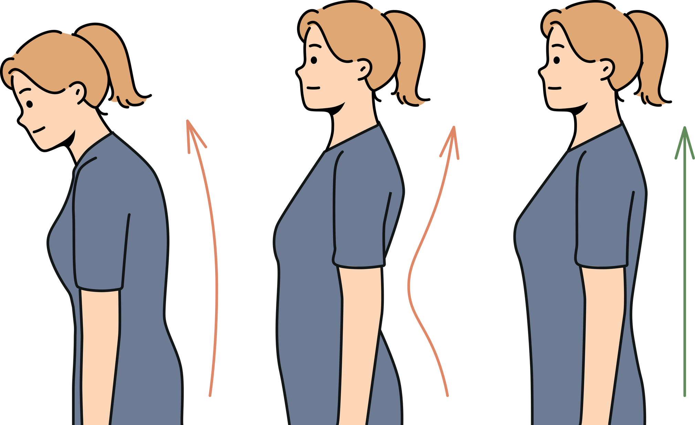


Why it Happens?
Too Much Sitting
Weak or Tight Muscles
Poor Posture

Slide 3


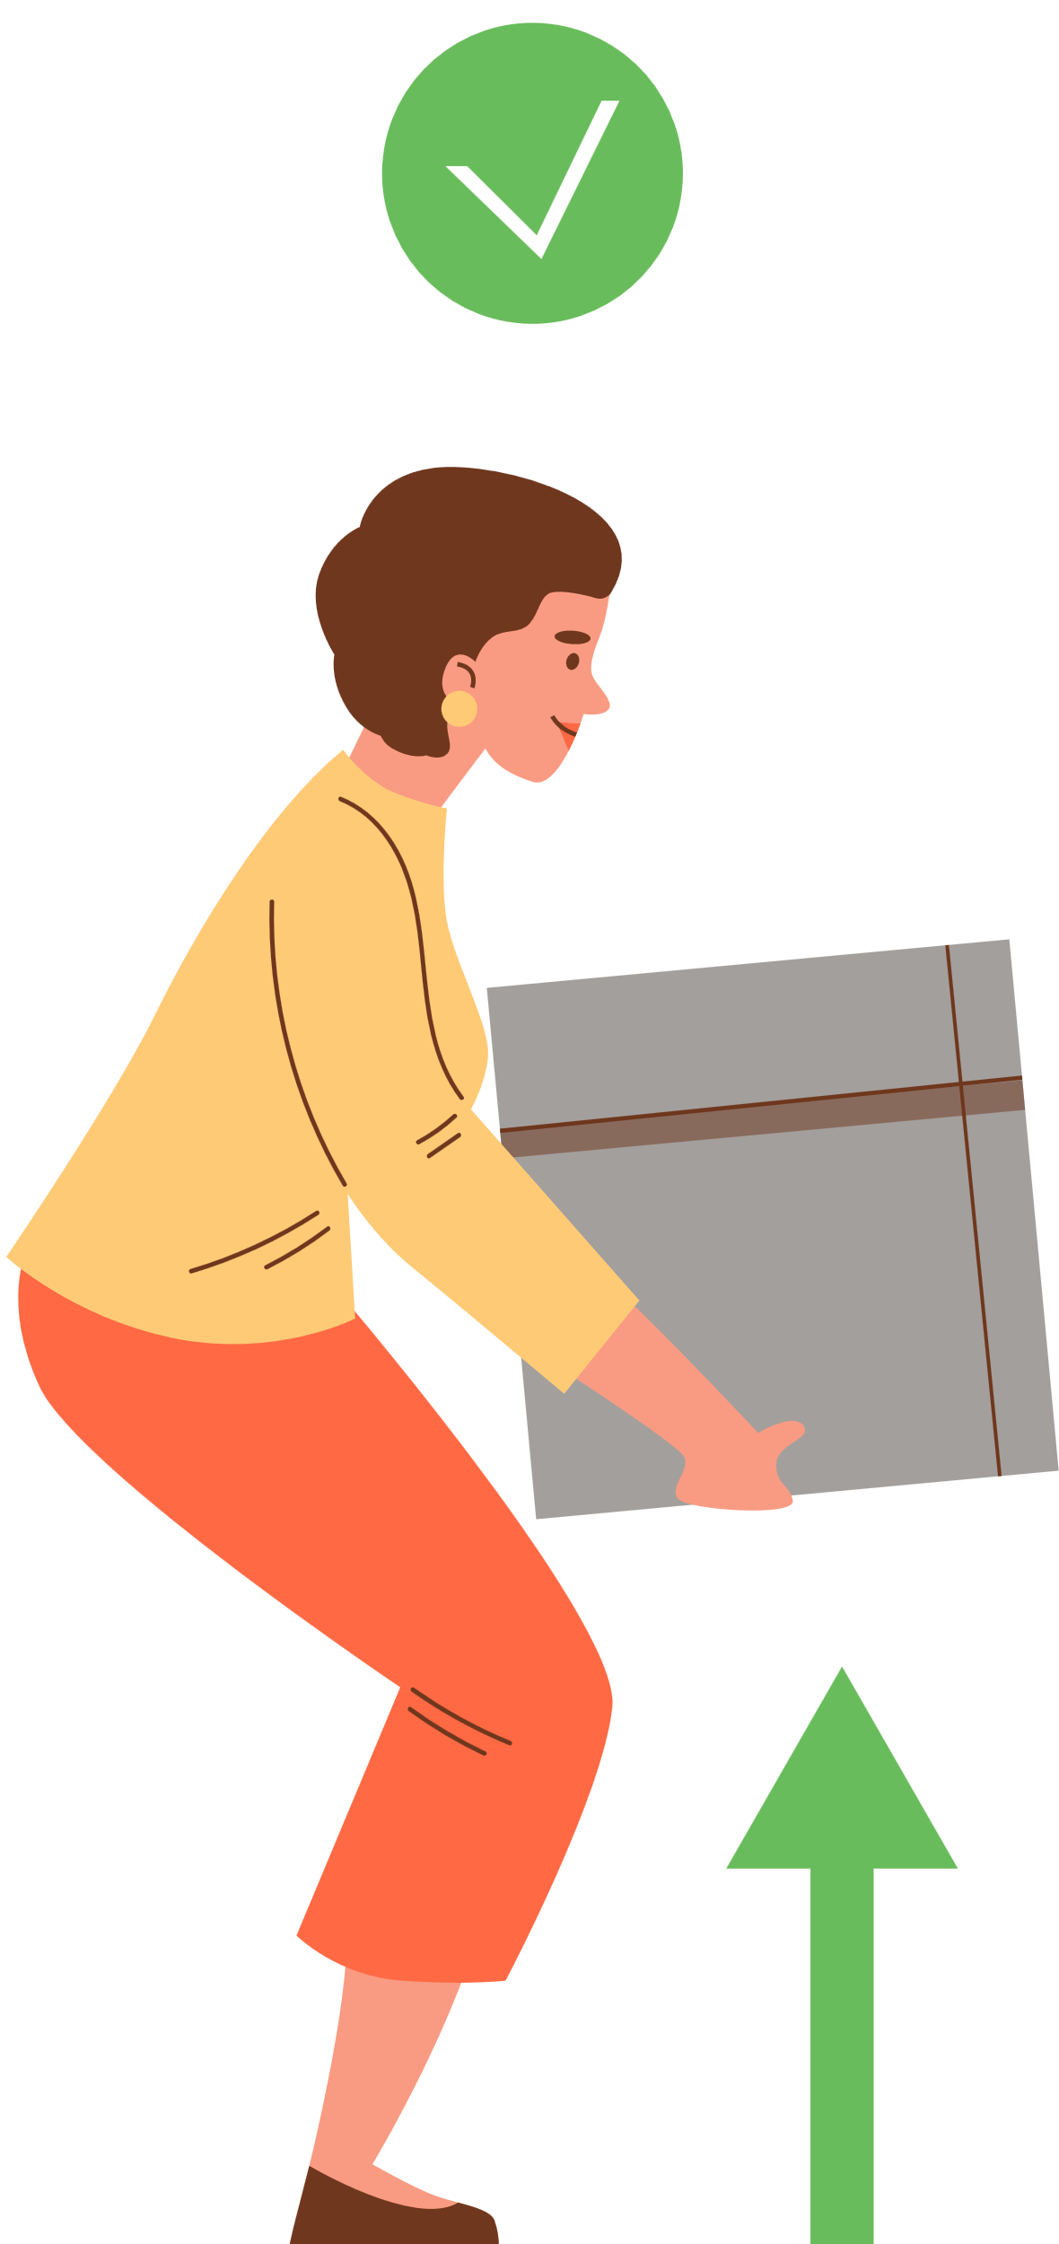
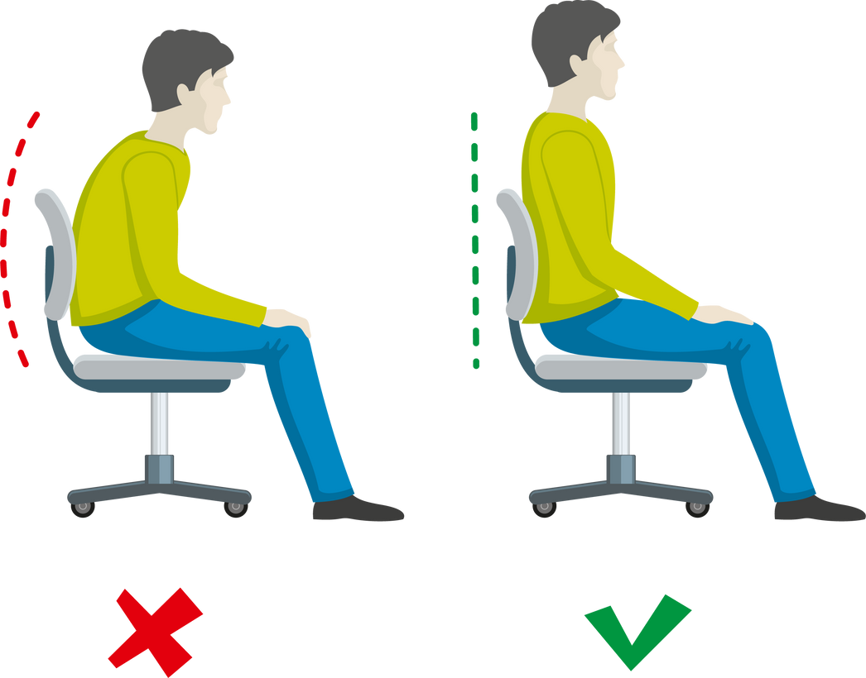
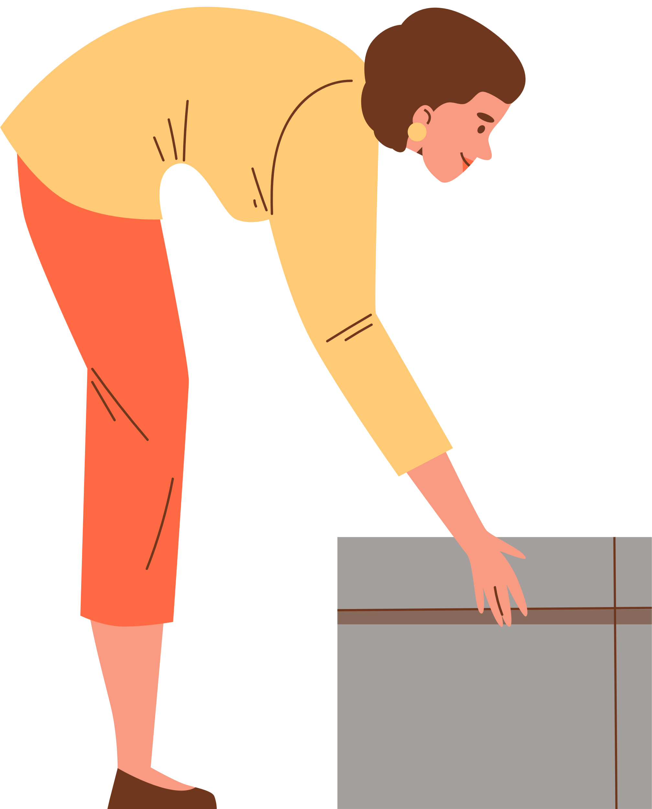

The Role of Posture
Lifting / Sitting
Sitting, standing, and lifting with proper alignment reduces stress on the spine

Slide 4

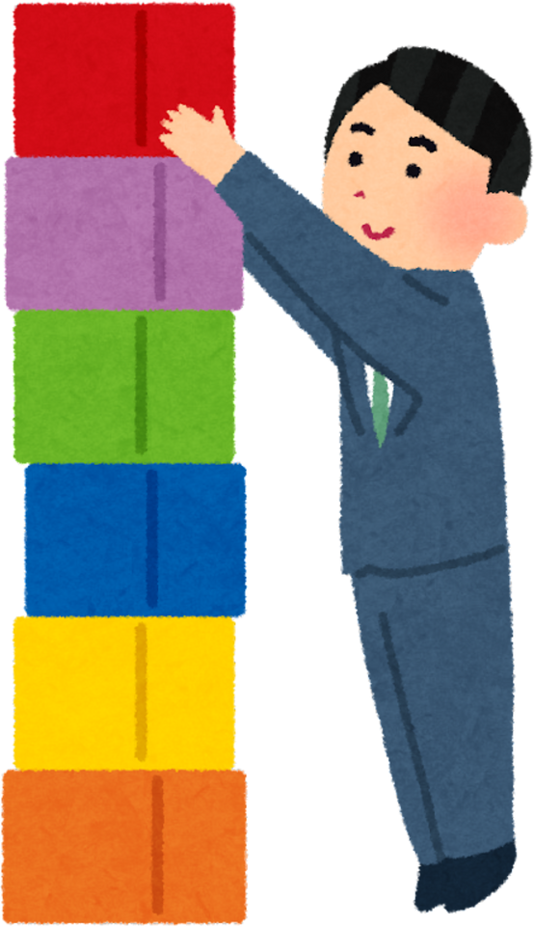
The Role of Posture
Lifting / Sitting
Think of your spine like a stack of blocks — if it’s aligned, it’s stable. Poor posture shifts weight and strains muscles

Slide 5
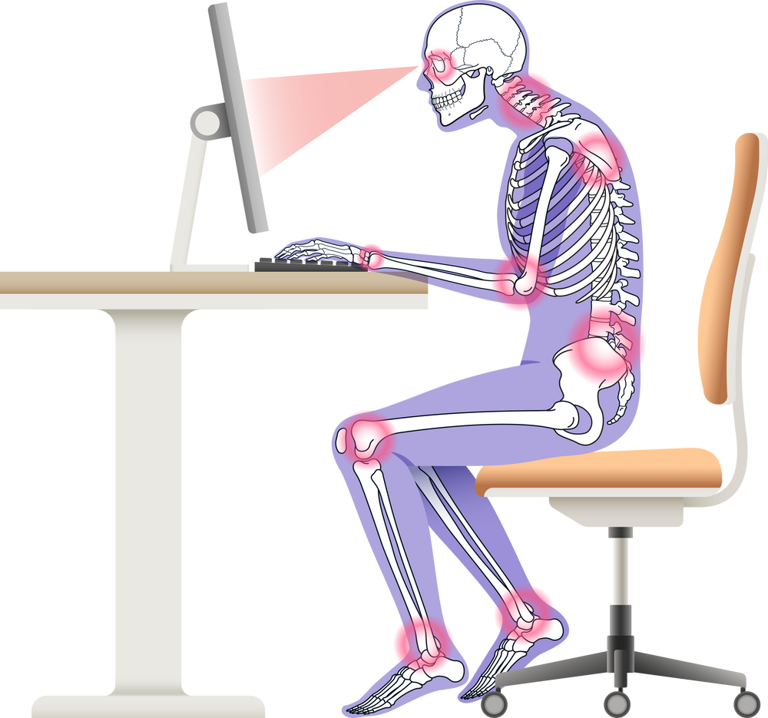
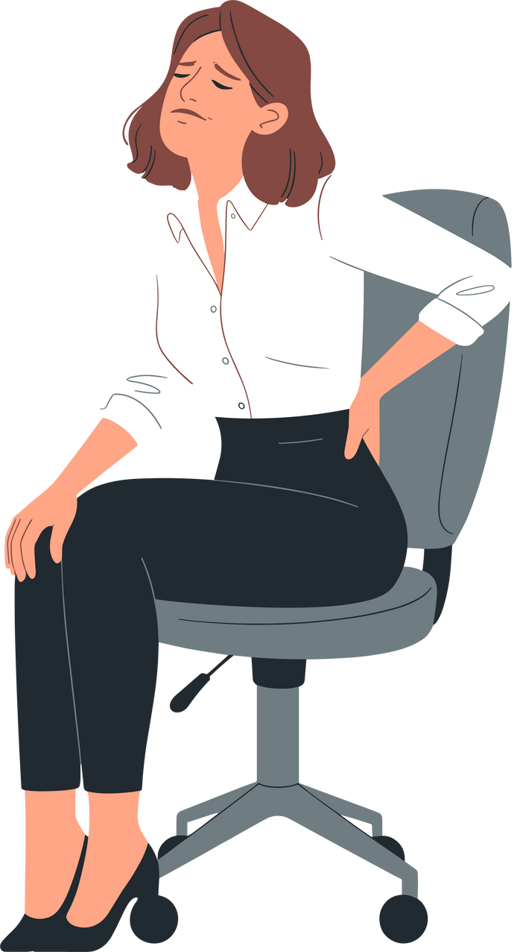
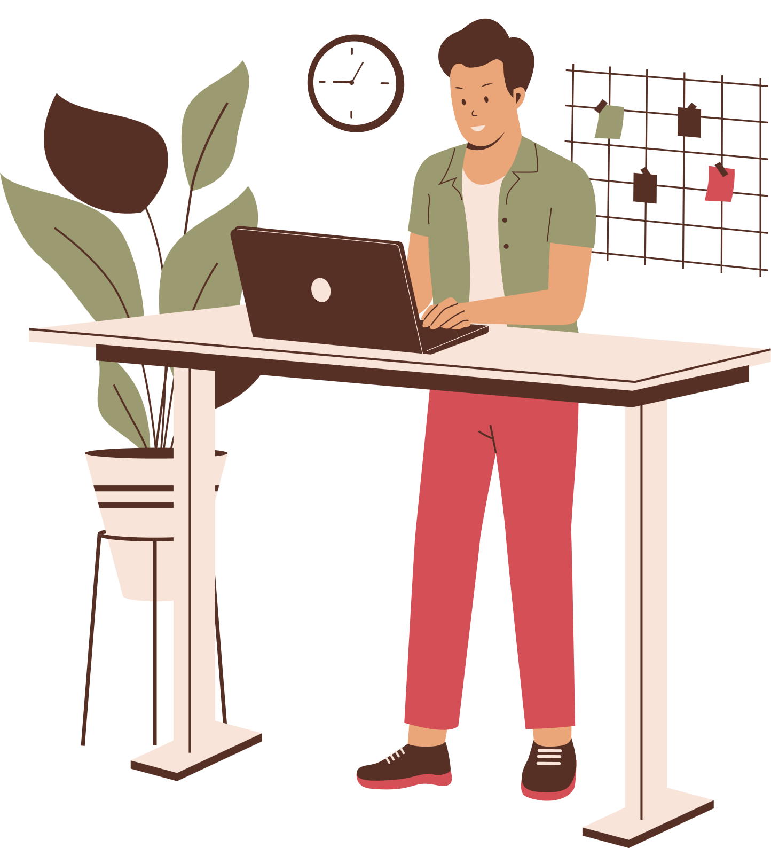


Workstation Check
Monitor at Eye Level
Chair Supports Lower Back
Feet Flat on Floor

Slide 6
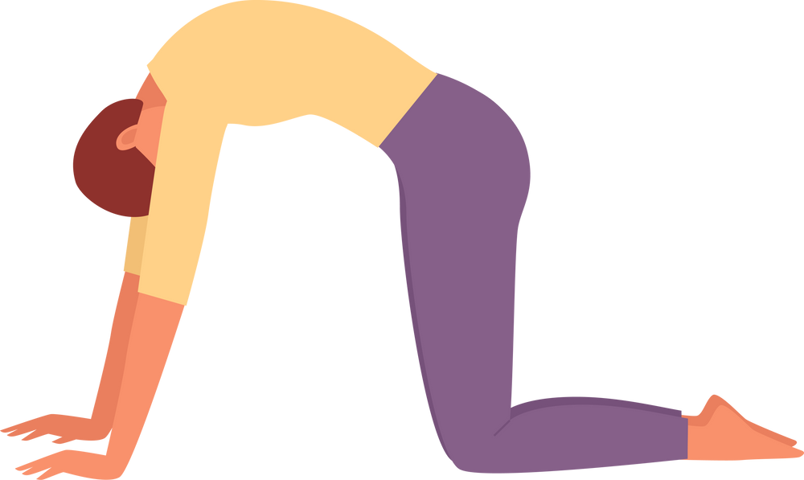
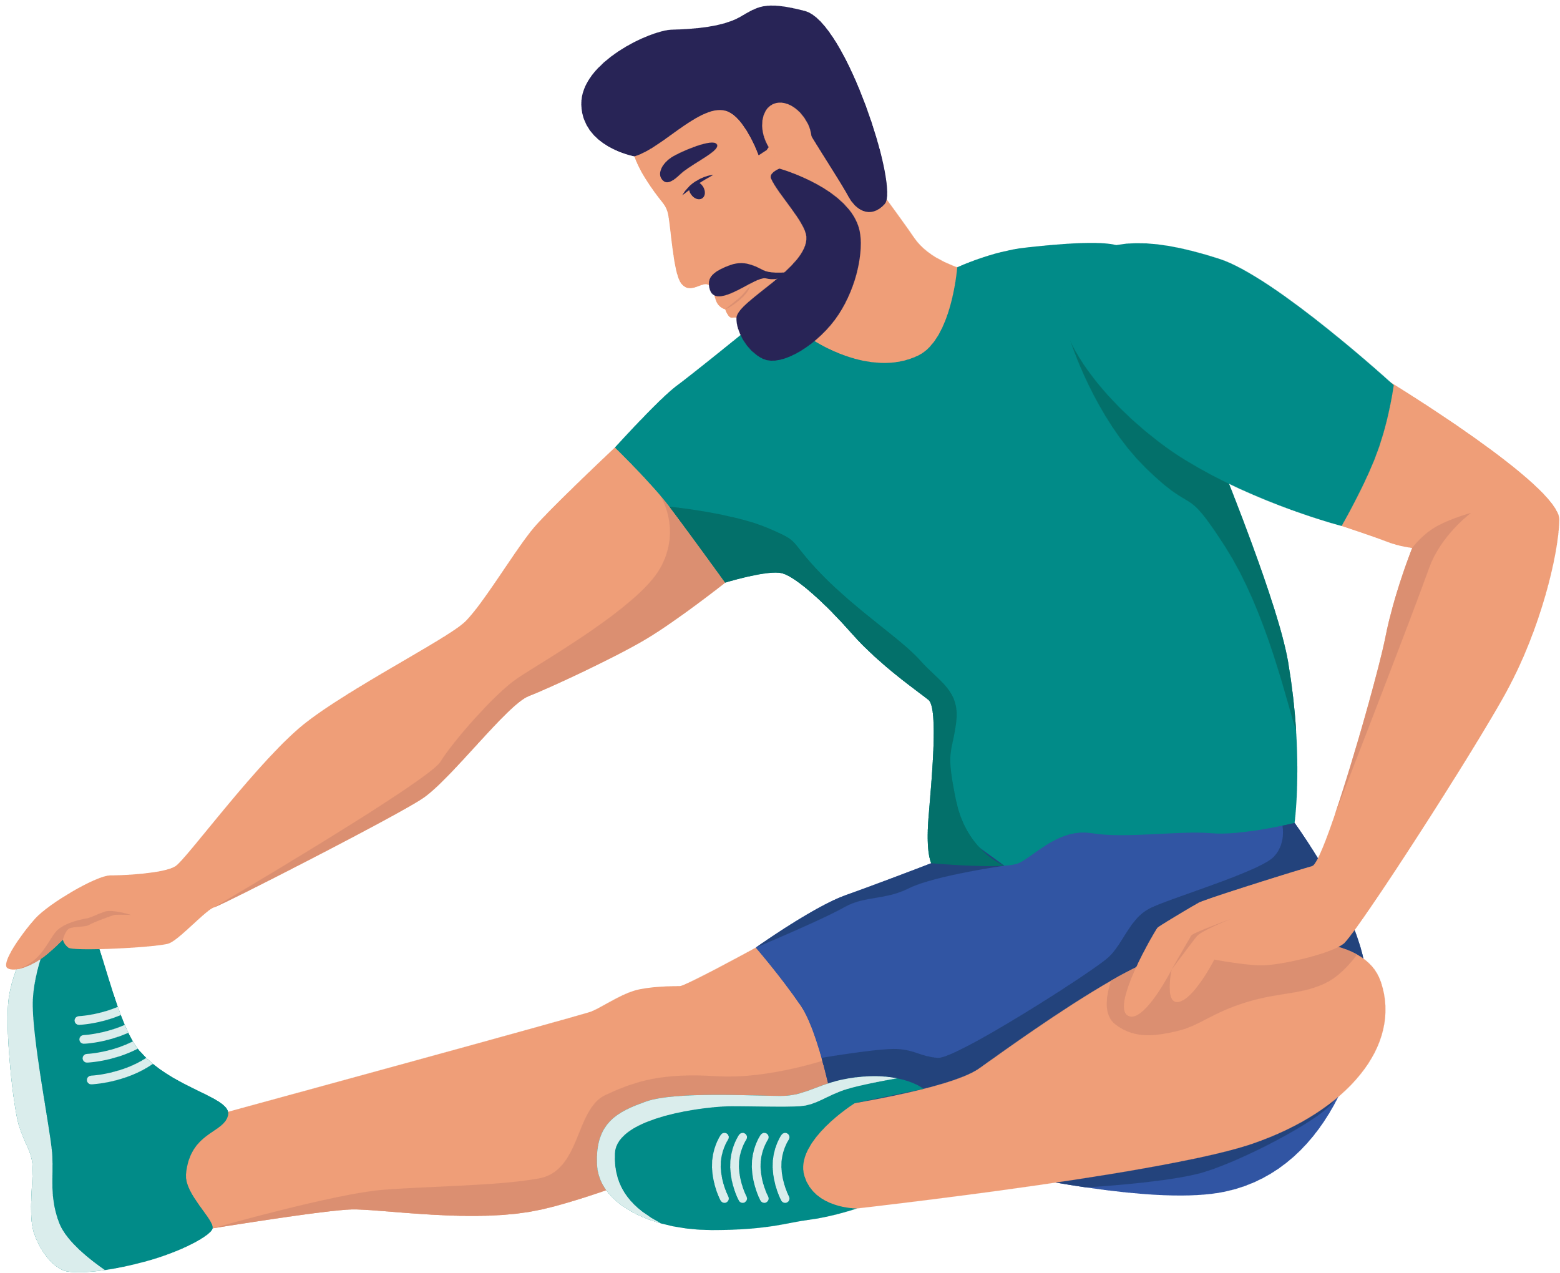
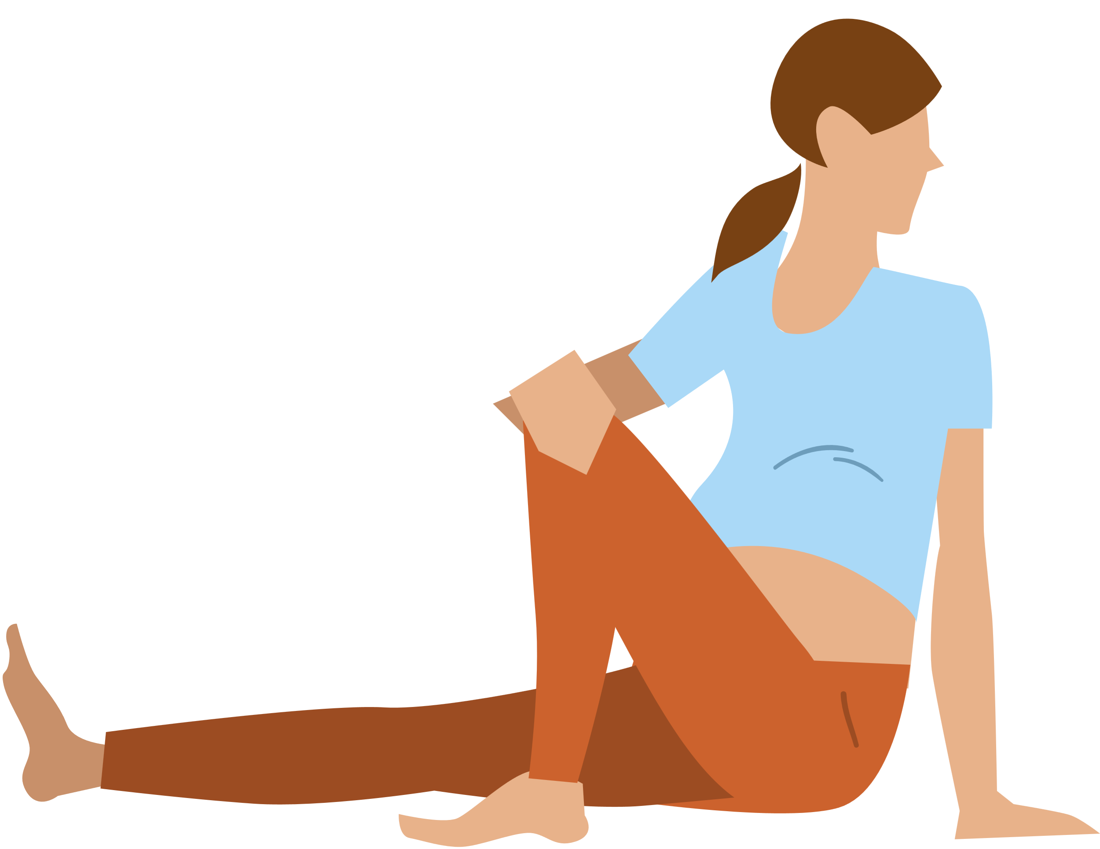
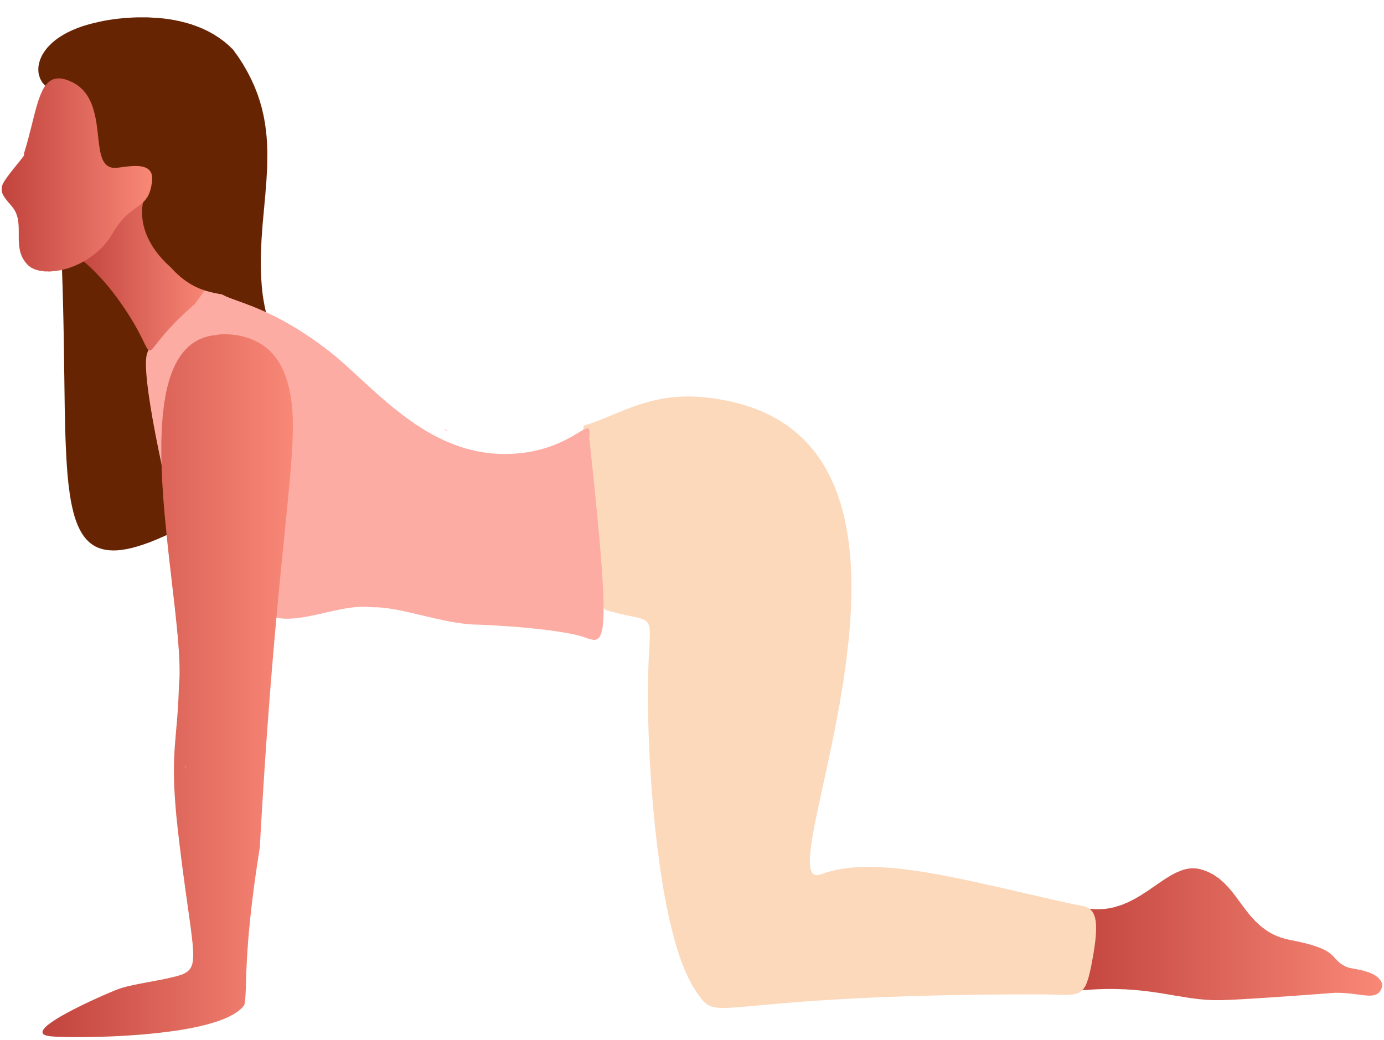
Stretching for Relief
Cat/Cow
Seated Twist
Hamstrings

Slide 7
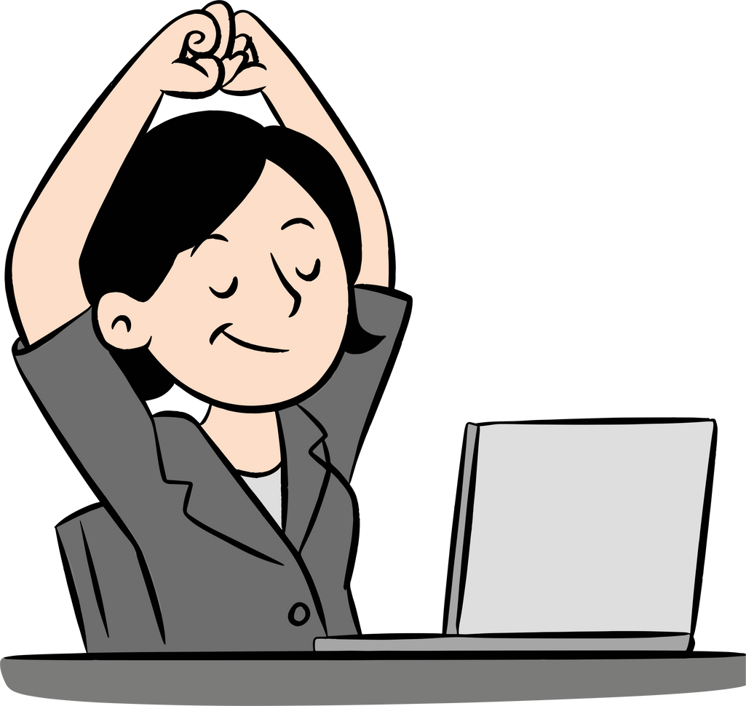
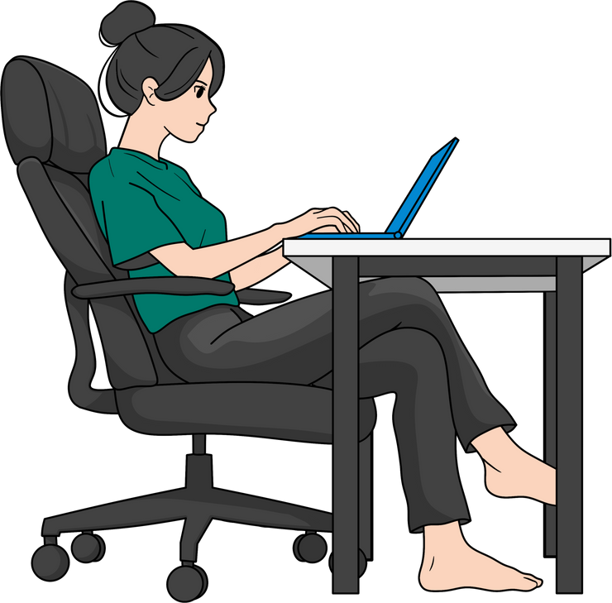
Everyday Movement Tips
Stand, Walk, Stretch Briefly
Avoid Long Periods of Stillness
Even short breaks matter. Your back loves variety, not being stuck in one position all day

Slide 8


Takeaway
3 Habits
  Sit tall
  Stretch daily
  Move often

